Slide 1

AJAX
Department of Computer Applications
CA722 Web Technology and its Applications
Presented by:
Abhiusnees Nandi (205122004)
Achintya Raj (205122006)
Akanksha Singh (205122008)
Radheshyam Ambhure (205122010)

Slide 2


Slide 3
Agenda
Introduction
What is AJAX?
How AJAX works
XMLHttpRequest
Functions and Properties
Examples
Advantages/Disadvantages
Conclusion

Slide 4
Introduction
AJAX is a developer's dream, because you can:
Update a web page without reloading the page
Request data from a server - after the page has loaded
Receive data from a server - after the page has loaded
Send data to a server - in the background

Slide 5
What is AJAX?
AJAX = Asynchronous JavaScript And XML.
AJAX is not a programming language.
AJAX just uses a combination of:
A browser built-in XMLHttpRequest object (to request data from a web server)
JavaScript and HTML DOM (to display or use the data)
AJAX is a misleading name. AJAX applications might use XML to transport data, but it is equally common to transport data as plain text or JSON text.
AJAX allows web pages to be updated asynchronously by exchanging data with a web server behind the scenes. This means that it is possible to update parts of a web page, without reloading the whole page.

Slide 6
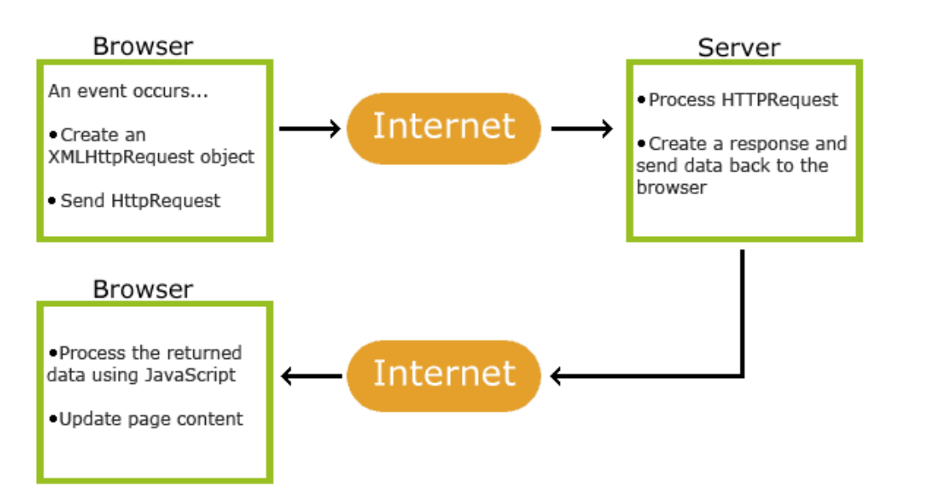
How AJAX works
An event occurs in a web page (the page is loaded, a button is clicked)
An XMLHttpRequest object is created by JavaScript
The XMLHttpRequest object sends a request to a web server
The server processes the request
The server sends a response back to the web page
The response is read by JavaScript
Proper action (like page update) is performed by JavaScript

Slide 7
Difference between Synchronous and Asynchronous Web Applications
Feature | Synchronous Web Applications | Asynchronous Web Applications
Request Handling | Client sends a request and waits for a response before proceeding. | Client sends a request and continues executing other tasks without waiting for a response immediately.
User Interface Responsiveness | Interface may appear unresponsive during request processing. | Allows for a more responsive user experience as the interface remains active while waiting for responses.
Server Resource Utilization Each request typically ties up Allows the server to handle
server resources until a response multiple requests concurrently
is sent. making more efficient use of resource.

Slide 8
Blocking Behavior Blocking behavior means the client is Non-blocking behavior enables the
halted until it receives a response. client to initiate multiple requests
without waiting for each one to complete.
Scalability Limited scalability under heavy Improved scalability as the server can handle
loads due to blocking nature. multiple concurrent requests efficiently.
Communication Follows a synchronous request- Supports asynchronous operations, enabling
Pattern response pattern. background tasks without blocking the main
execution flow.
Page Reloads Often involves full page reloads Enables dynamic updates without full page
for each action. reloads, providing a smoother user experience.
Examples Traditional web applications where Modern web applications using AJAX
interactions trigger page reloads. Web Sockets, or JavaScript frameworks like
React, Angular, or Vue.
Technologies Primarily relies on synchronous Utilizes asynchronous techniques such as AJAX,
communication protocols like HTTP. Web Sockets, or server-sent events (SSE).

Slide 9
The XMLHttpRequest Object
The keystone of AJAX is the XMLHttpRequest object.
All modern browsers (Chrome, Firefox, Edge (and IE7+), Safari, Opera) have a built-in XMLHttpRequest object.
The XMLHttpRequest object can be used to exchange data with a server behind the scenes. This means that it is possible to update parts of a web page, without reloading the whole page.
For security reasons, modern browsers do not allow access across domains.
This means that both the web page and the XML file it tries to load, must be located on the same server.

Slide 10
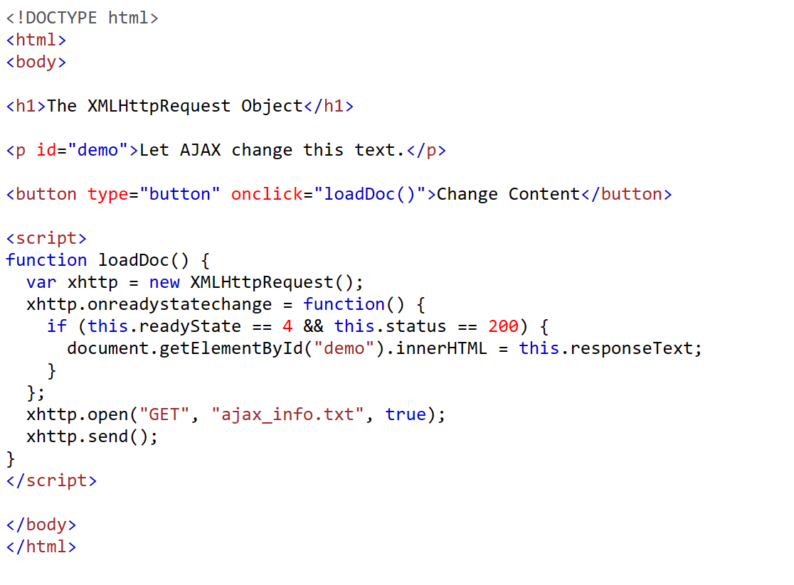
index.html

Slide 11
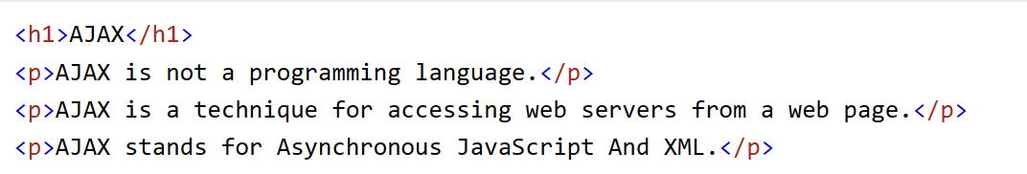
ajax_info.txt

Slide 12
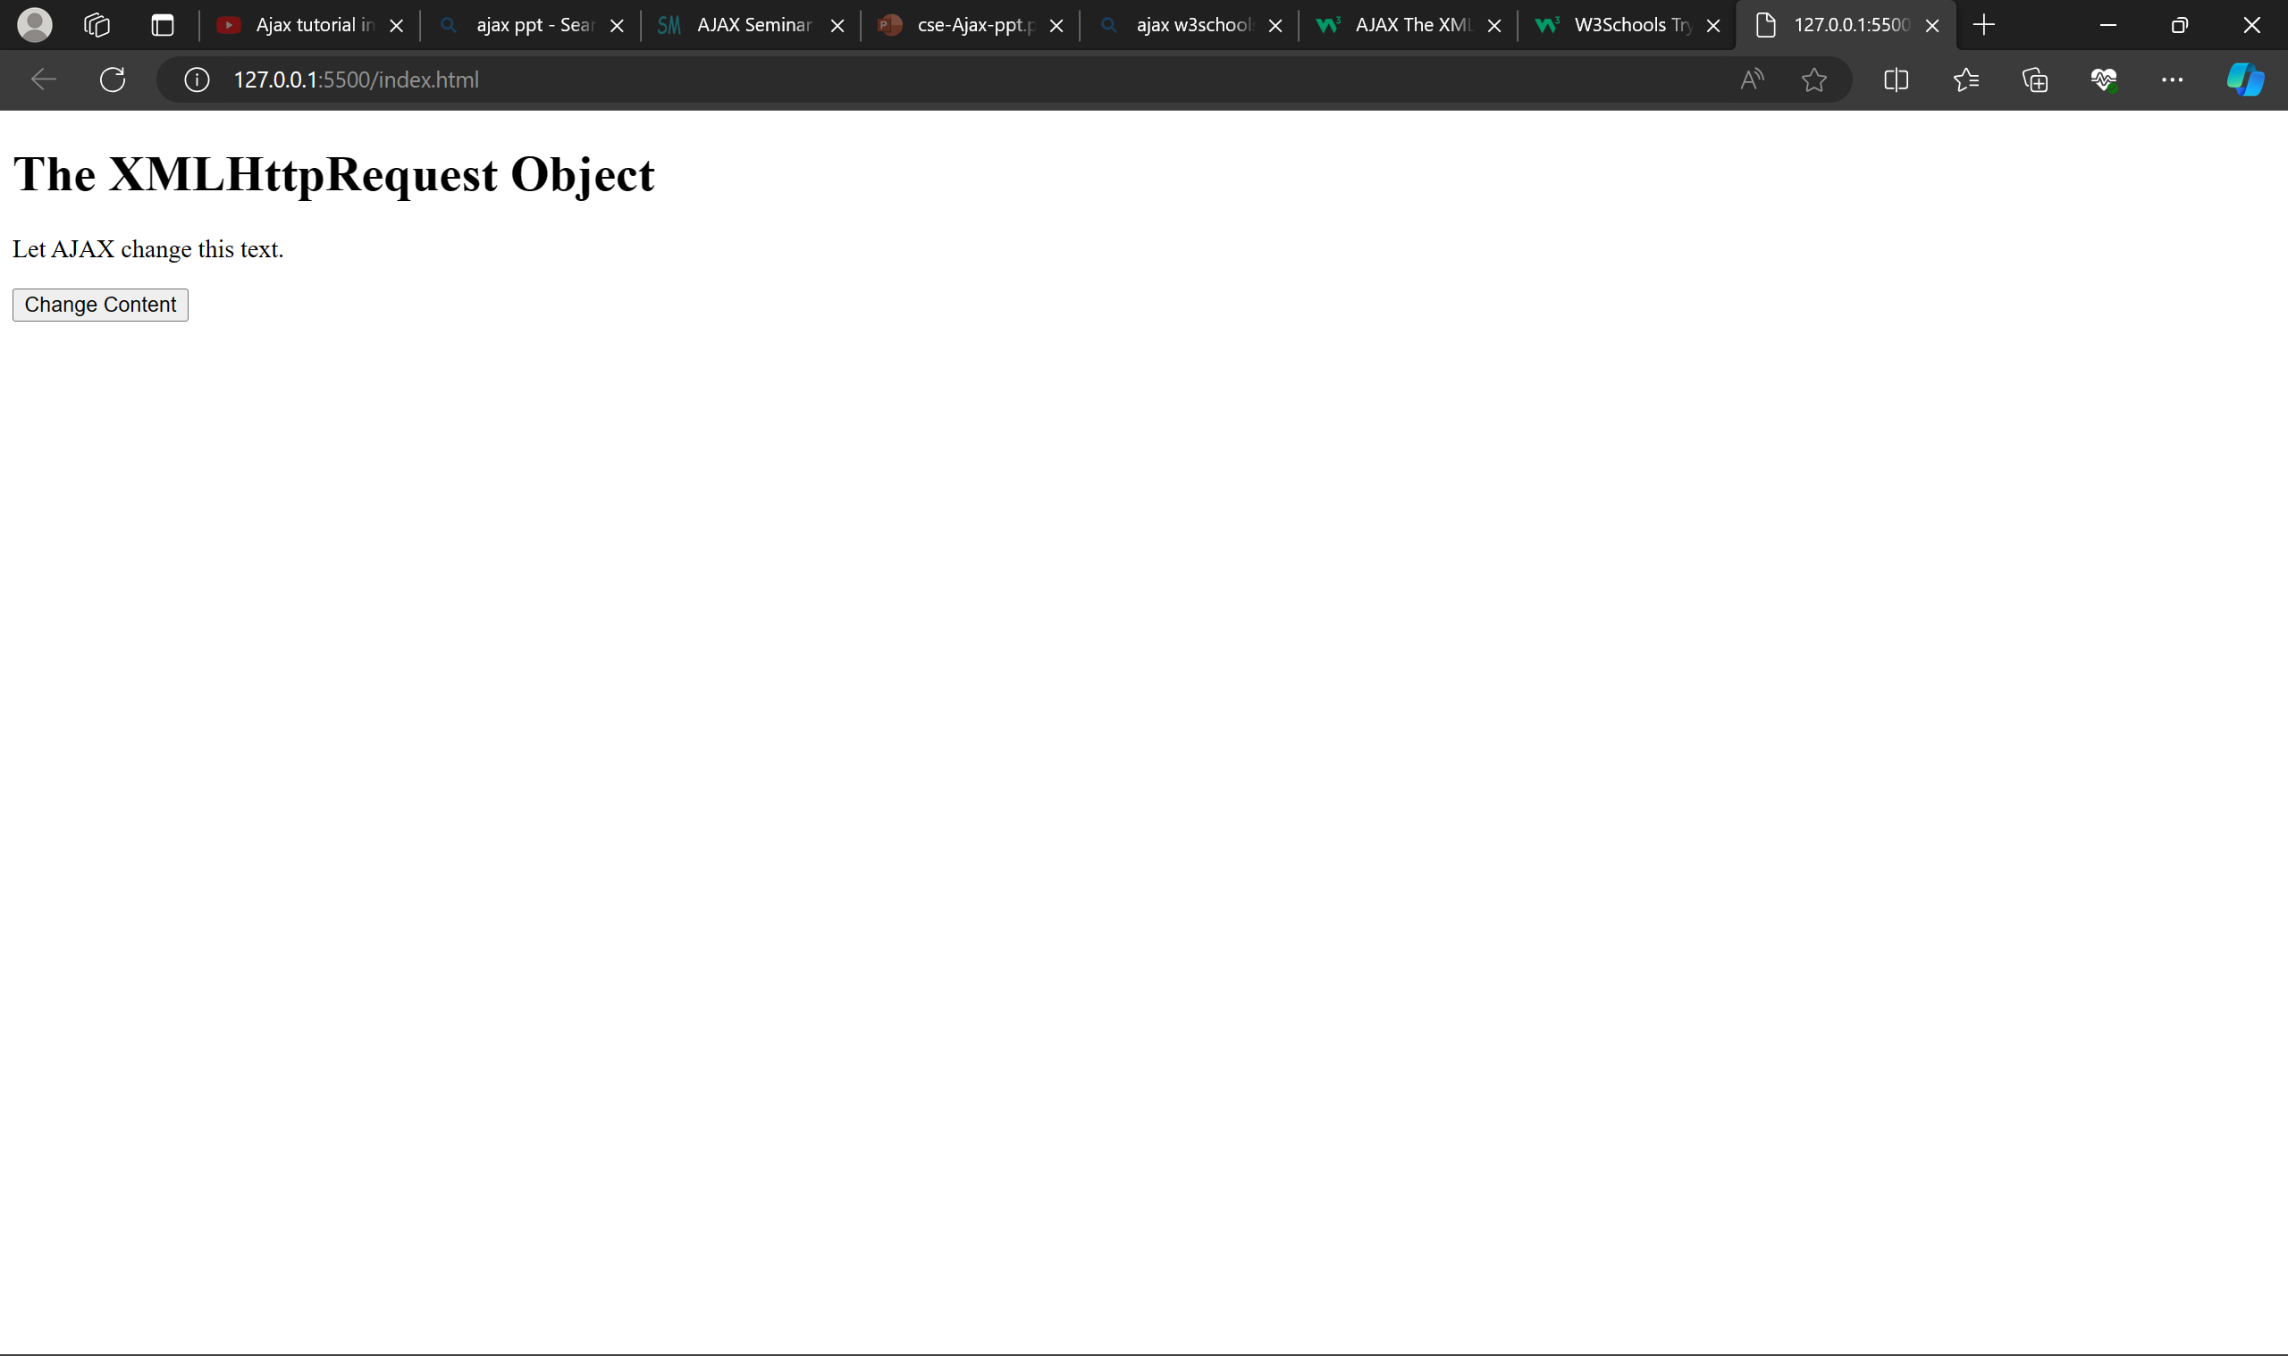

Slide 13
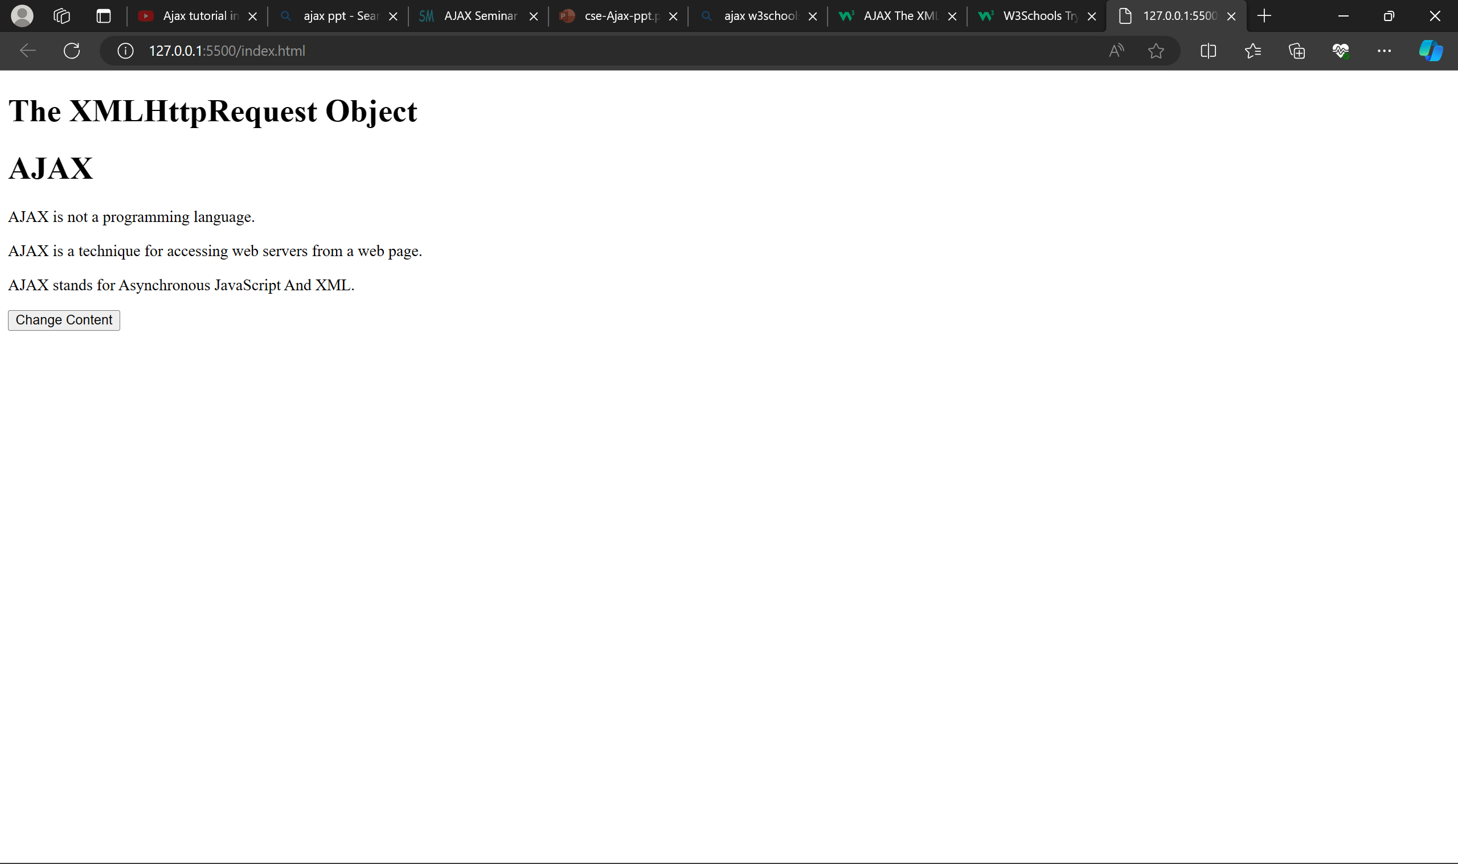

Slide 14
XMLHttpRequest Object Methods
Method | Description
new XMLHttpRequest() | Creates a new XMLHttpRequest object
abort() | Cancels the current request
getAllResponseHeaders() | Returns header information
getResponseHeader() | Returns specific header information
open(method,url,async,user,psw) | Specifies the request method: the request type GET or POST url: the file location async: true (asynchronous) or false (synchronous) user: optional user name psw: optional password
send() | Sends the request to the server Used for GET requests
send(string) | Sends the request to the server. Used for POST requests
setRequestHeader() | Adds a label/value pair to the header to be sent

Slide 15
XMLHttpRequest Object Properties
Property | Description
onreadystatechange | Defines a function to be called when the readyState property changes
readyState | Holds the status of the XMLHttpRequest. 0: request not initialized 1: server connection established 2: request received 3: processing request 4: request finished and response is ready
responseText | Returns the response data as a string
responseXML | Returns the response data as XML data
status | Returns the status-number of a request 200: "OK" 403: "Forbidden" 404: "Not Found" For a complete list go to the Http Messages Reference
statusText | Returns the status-text (e.g. "OK" or "Not Found")

Slide 16
Send a Request To a Server
To send a request to a server, we use the open() and send() methods of the XMLHttpRequest object:
xhttp.open("GET", "ajax_info.txt", true); xhttp.send();
Method | Description
open(method, url, async) | Specifies the type of request method: the type of request: GET or POST url: the server (file) location async: true (asynchronous) or false (synchronous)
send() | Sends the request to the server (used for GET)
send(string) | Sends the request to the server (used for POST)

Slide 17
Send a Request To a Server
GET or POST?
GET is simpler and faster than POST, and can be used in most cases.
However, always use POST requests when:
A cached file is not an option (update a file or database on the server).
Sending a large amount of data to the server (POST has no size limitations).
Sending user input (which can contain unknown characters), POST is more robust and secure than GET.

Slide 18
Send a Request To a Server
The url - A File On a Server
The url parameter of the open() method, is an address to a file on a server:
The file can be any kind of file, like .txt and .xml, or server scripting files like .asp and .php (which can perform actions on the server before sending the response back).

Slide 19
Send a Request To a Server
Asynchronous - True or False?
Server requests should be sent asynchronously.
The async parameter of the open() method should be set to “true”:
xhttp.open("GET", "ajax_test.xml", true);
By sending asynchronously, the JavaScript does not have to wait for the server response, but can instead:
execute other scripts while waiting for server response
deal with the response after the response is ready

Slide 20
Send a Request To a Server
Synchronous Request
To execute a synchronous request, change the third parameter in the open() method to false:
xhttp.open("GET", "ajax_info.txt", false);
Sometimes async = false are used for quick testing. You will also find synchronous requests in older JavaScript code.
Since the code will wait for server completion, there is no need for an onreadystatechange function

Slide 21
Send a Request To a Server
Synchronous Request
Synchronous XMLHttpRequest (async = false) is not recommended because the JavaScript will stop executing until the server response is ready. If the server is busy or slow, the application will hang or stop.
Synchronous XMLHttpRequest is in the process of being removed from the web standard, but this process can take many years.
Modern developer tools are encouraged to warn about using synchronous requests and may throw an InvalidAccessError exception when it occurs.

Slide 22
Server Response
The onreadystatechange Property
The readyState property holds the status of the XMLHttpRequest.
The onreadystatechange property defines a function to be executed when the readyState changes.
The status property and the statusText property holds the status of the XMLHttpRequest object.
The onreadystatechange event is triggered four times (1-4), one time for each change in the readyState.
Property | Description
onreadystatechange | Defines a function to be called when the readyState property changes
readyState | Holds the status of the XMLHttpRequest. 0: request not initialized 1: server connection established 2: request received 3: processing request 4: request finished and response is ready
status | 200: "OK" 403: "Forbidden" 404: "Page not found" For a complete list go to the Http Messages Reference
statusText | Returns the status-text (e.g. "OK" or "Not Found")

Slide 23
Server Response Properties
Property | Description
responseText | get the response data as a string
responseXML | get the response data as XML data

Slide 24
Server Response Properties
The responseXML Property
The XML HttpRequest object has an in-built XML parser.
The responseXML property returns the server response as an XML DOM object.
Using this property you can parse the response as an XML DOM object:

Slide 25
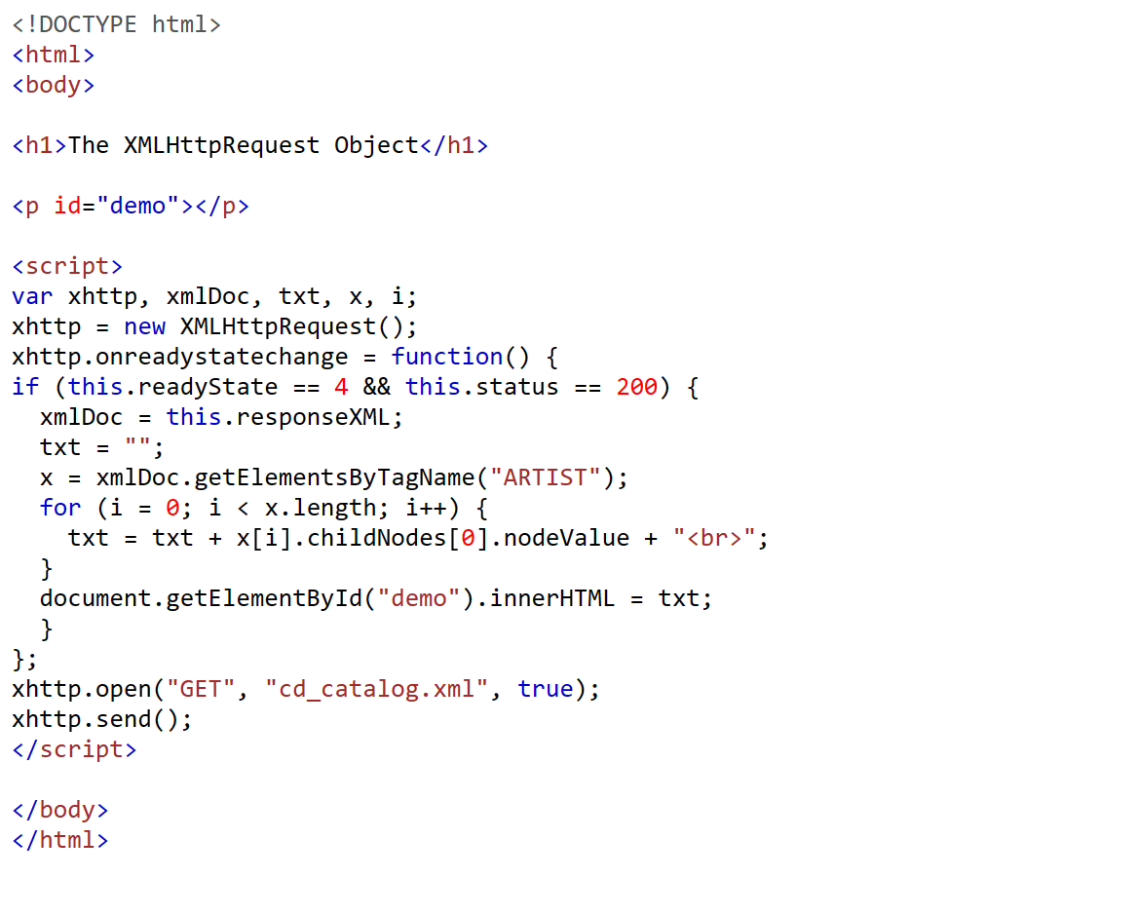
responseXML

Slide 26
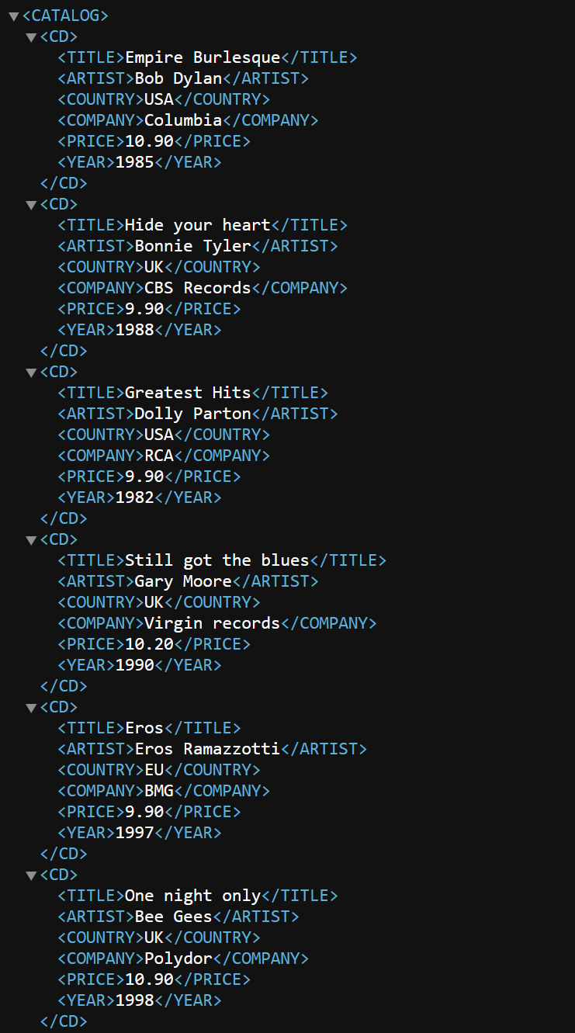
responseXML

Slide 27
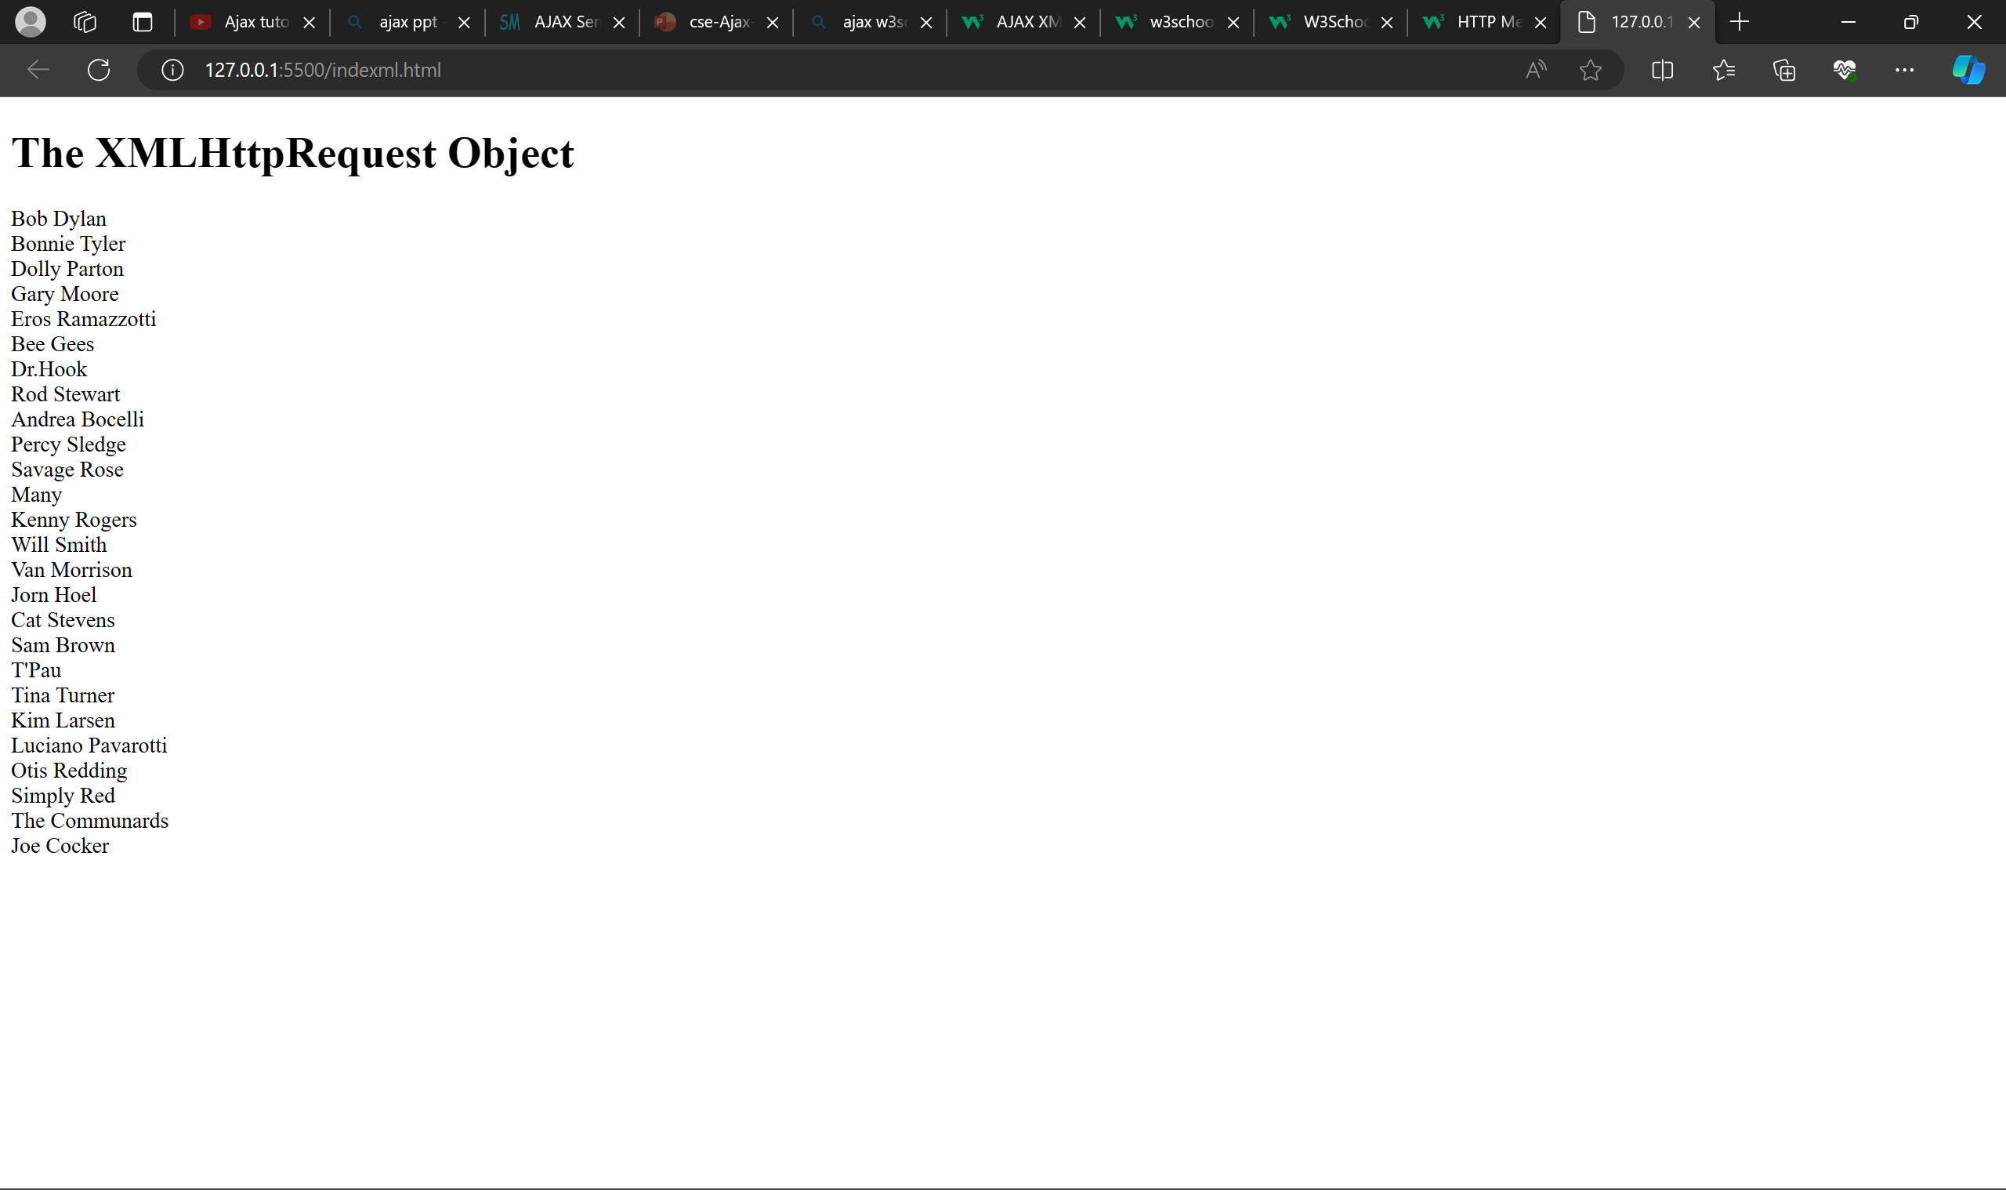
responseXML

Slide 28
AJAX XML Example
AJAX can be used for interactive communication with an XML file.
The following example will demonstrate how a web page can fetch information from an XML file with AJAX:

Slide 29
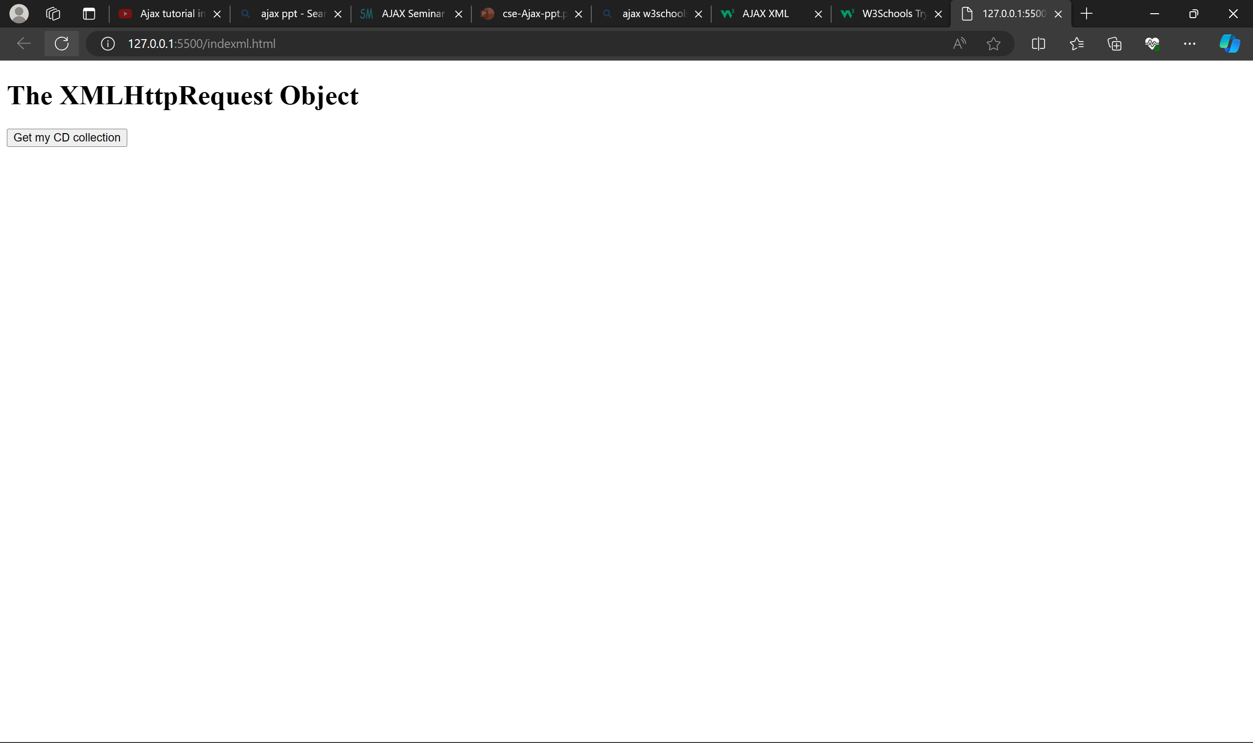
AJAX XML Example

Slide 30
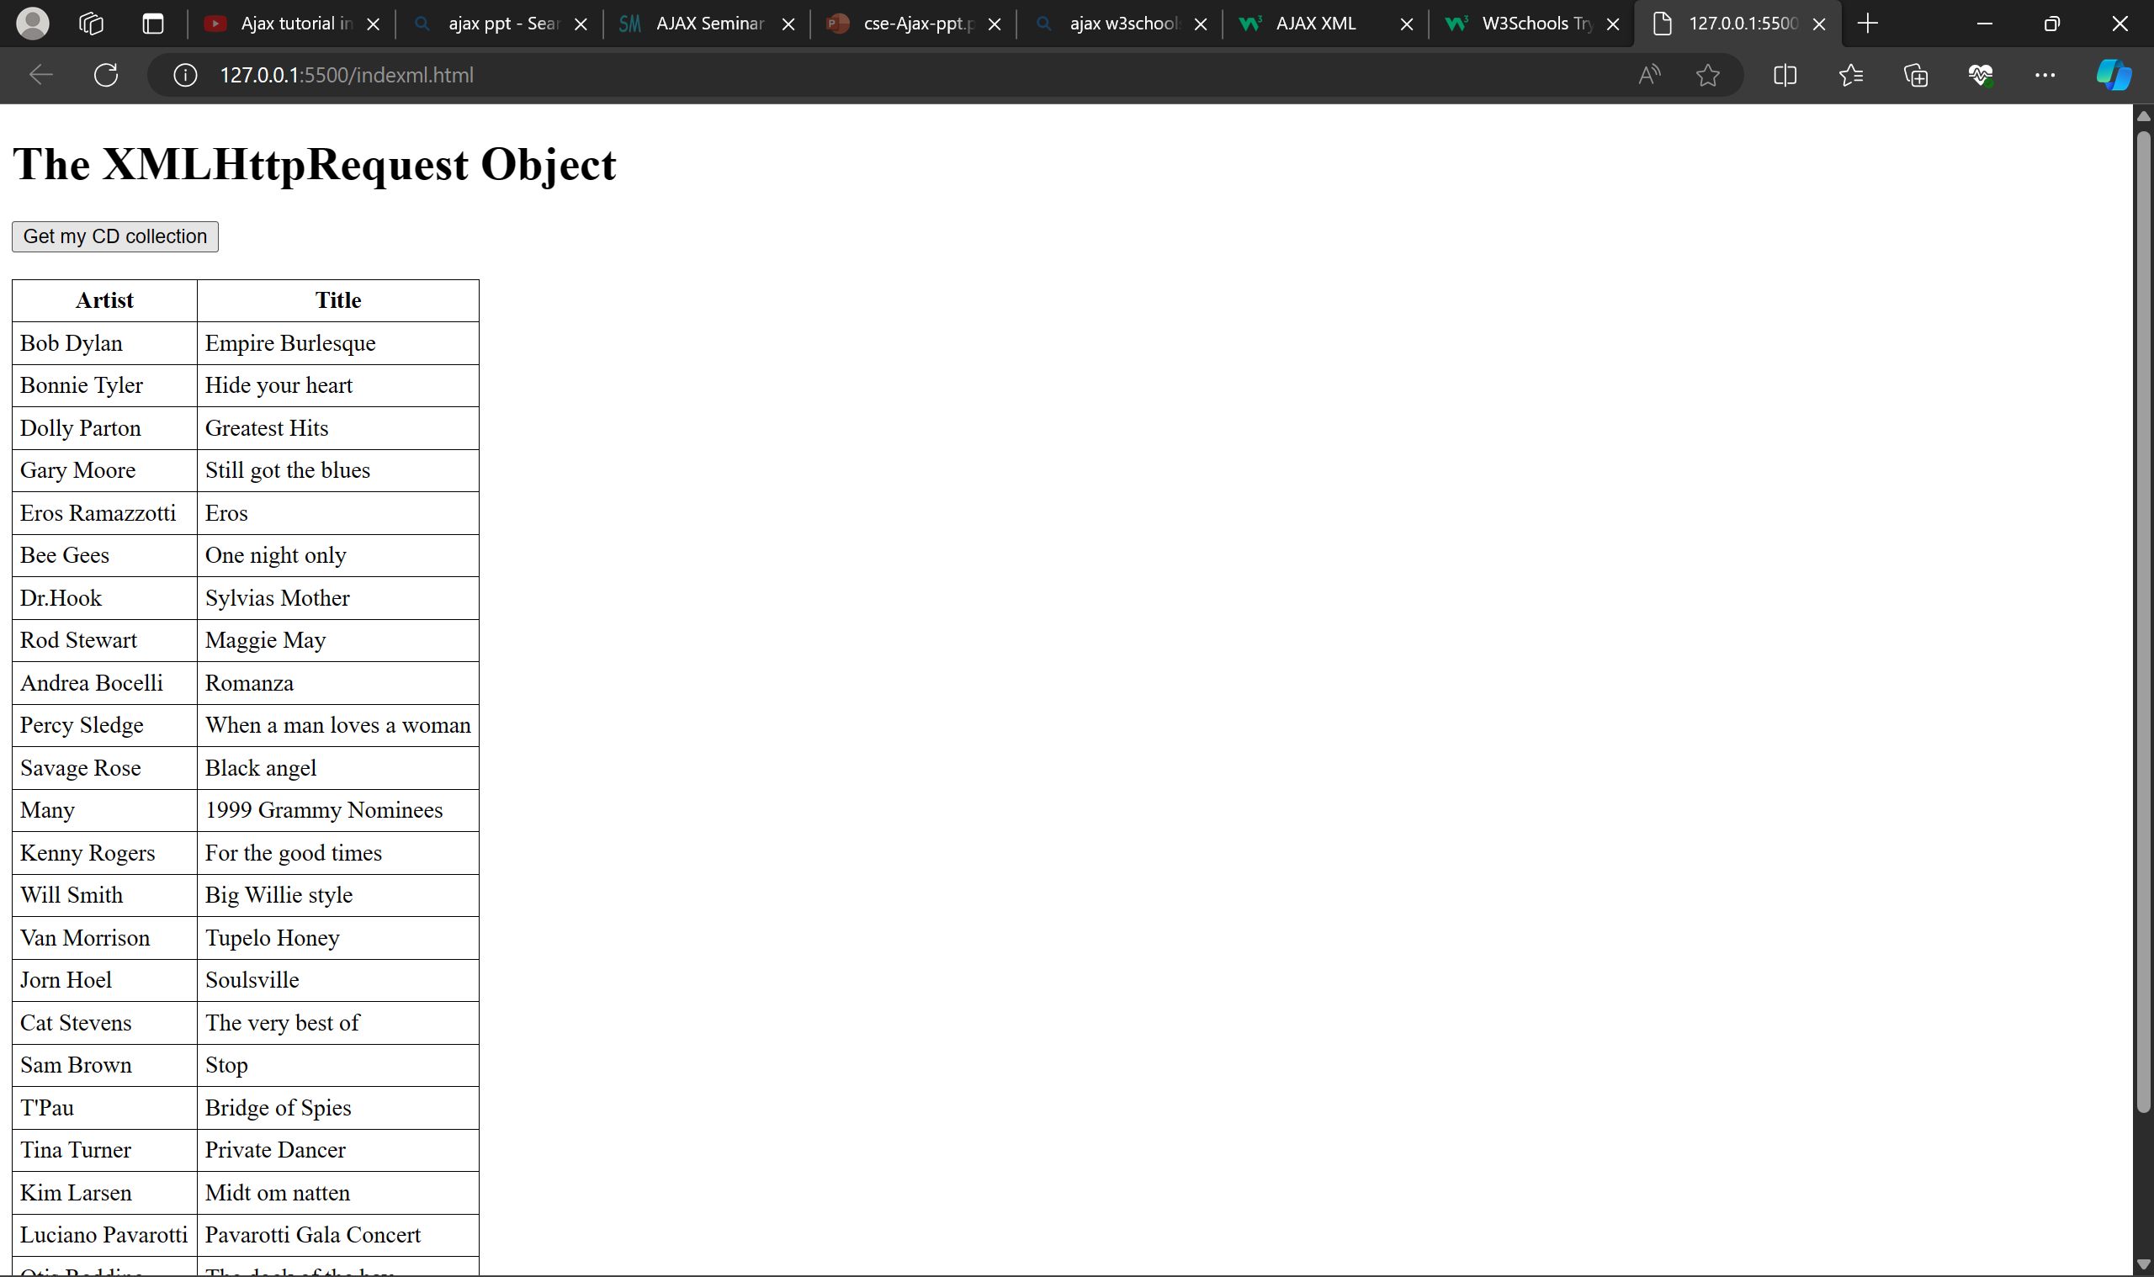
AJAX XML Example

Slide 31
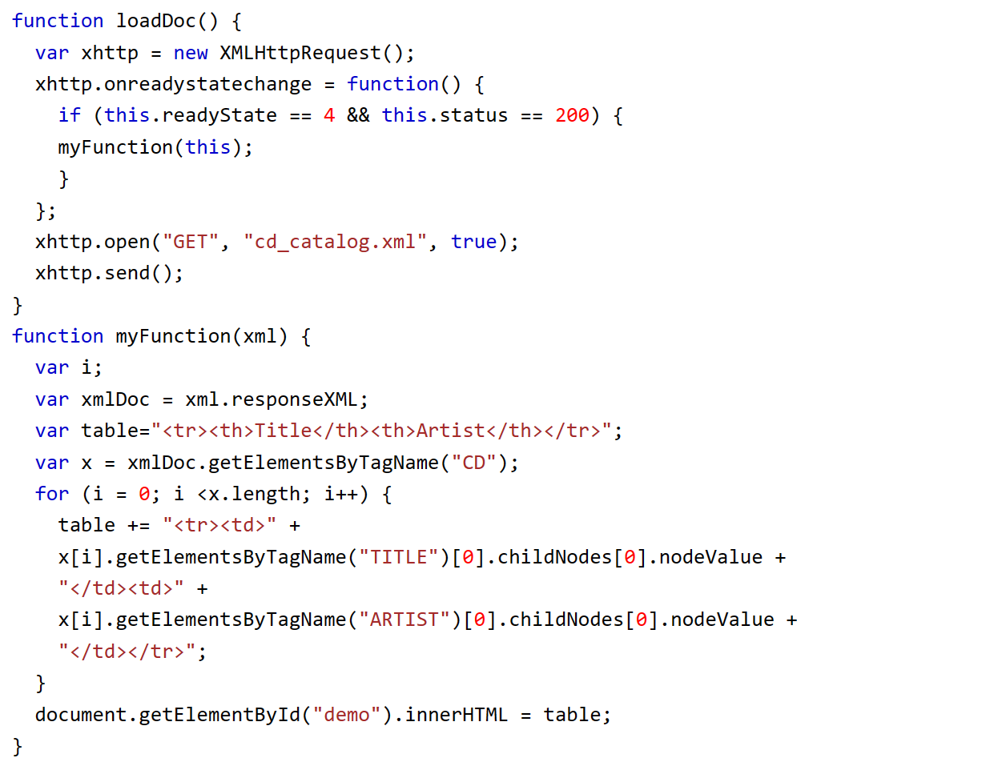
AJAX XML Example
When a user clicks on the "Get CD info" button above, the loadDoc() function is executed.
The loadDoc() function creates an XMLHttpRequest object, adds the function to be executed when the server response is ready, and sends the request off to the server.
When the server response is ready, an HTML table is built, nodes (elements) are extracted from the XML file, and it finally updates the element "demo" with the HTML table filled with XML data:

Slide 32
more examples
Navigate Between the CDs

Slide 33
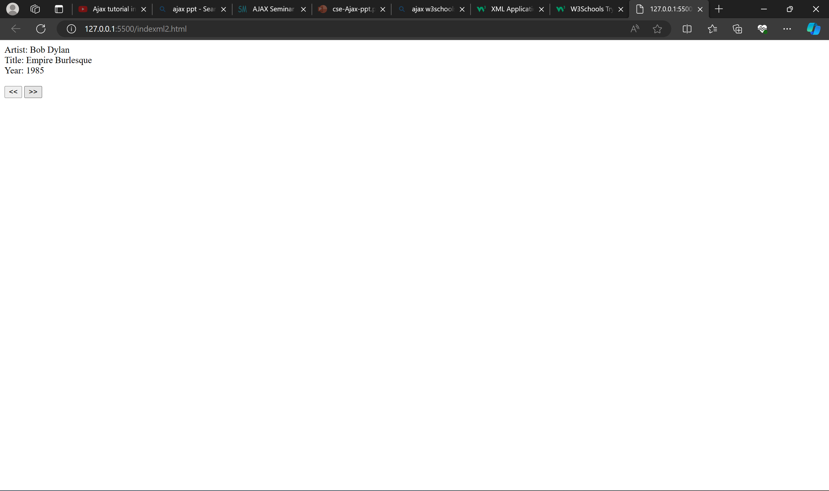

Slide 34


Slide 35
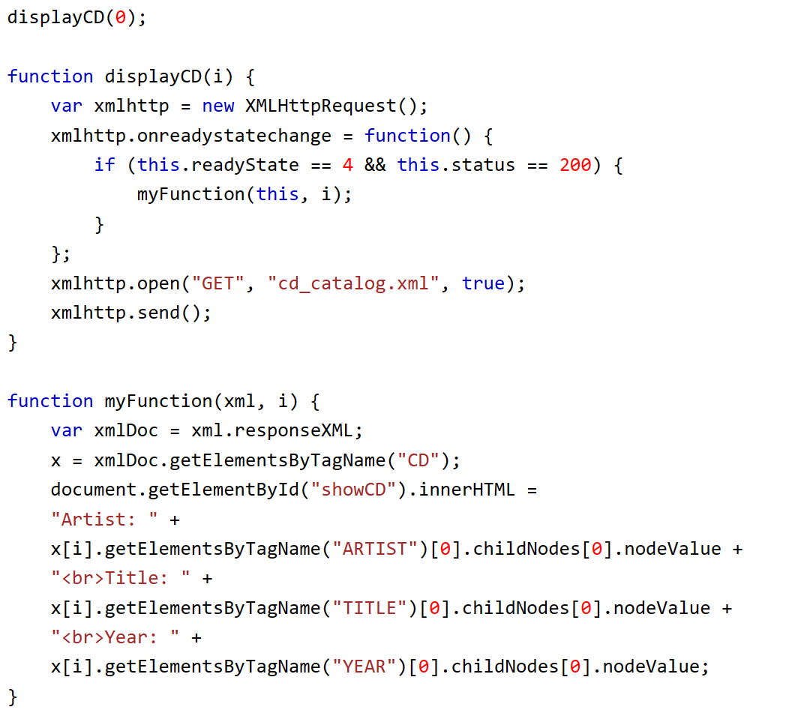
more examples
Navigate Between the CDs
This example uses a function to display the first CD element in an HTML element with id="showCD":

Slide 36
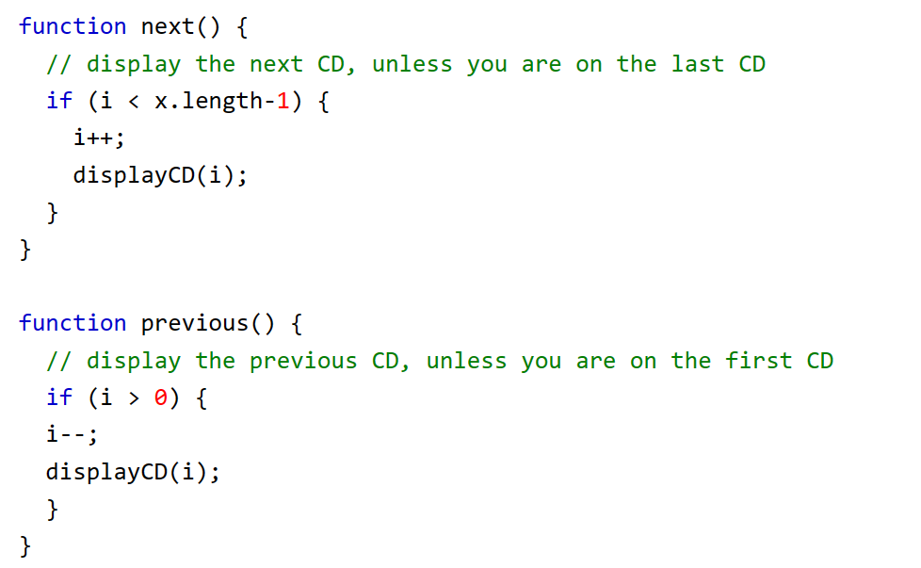
more examples
Navigate Between the CDs
To navigate between the CDs, in the example above, add a next() and previous() function:

Slide 37
more examples
Show Album Information When Clicking On a CD

Slide 38
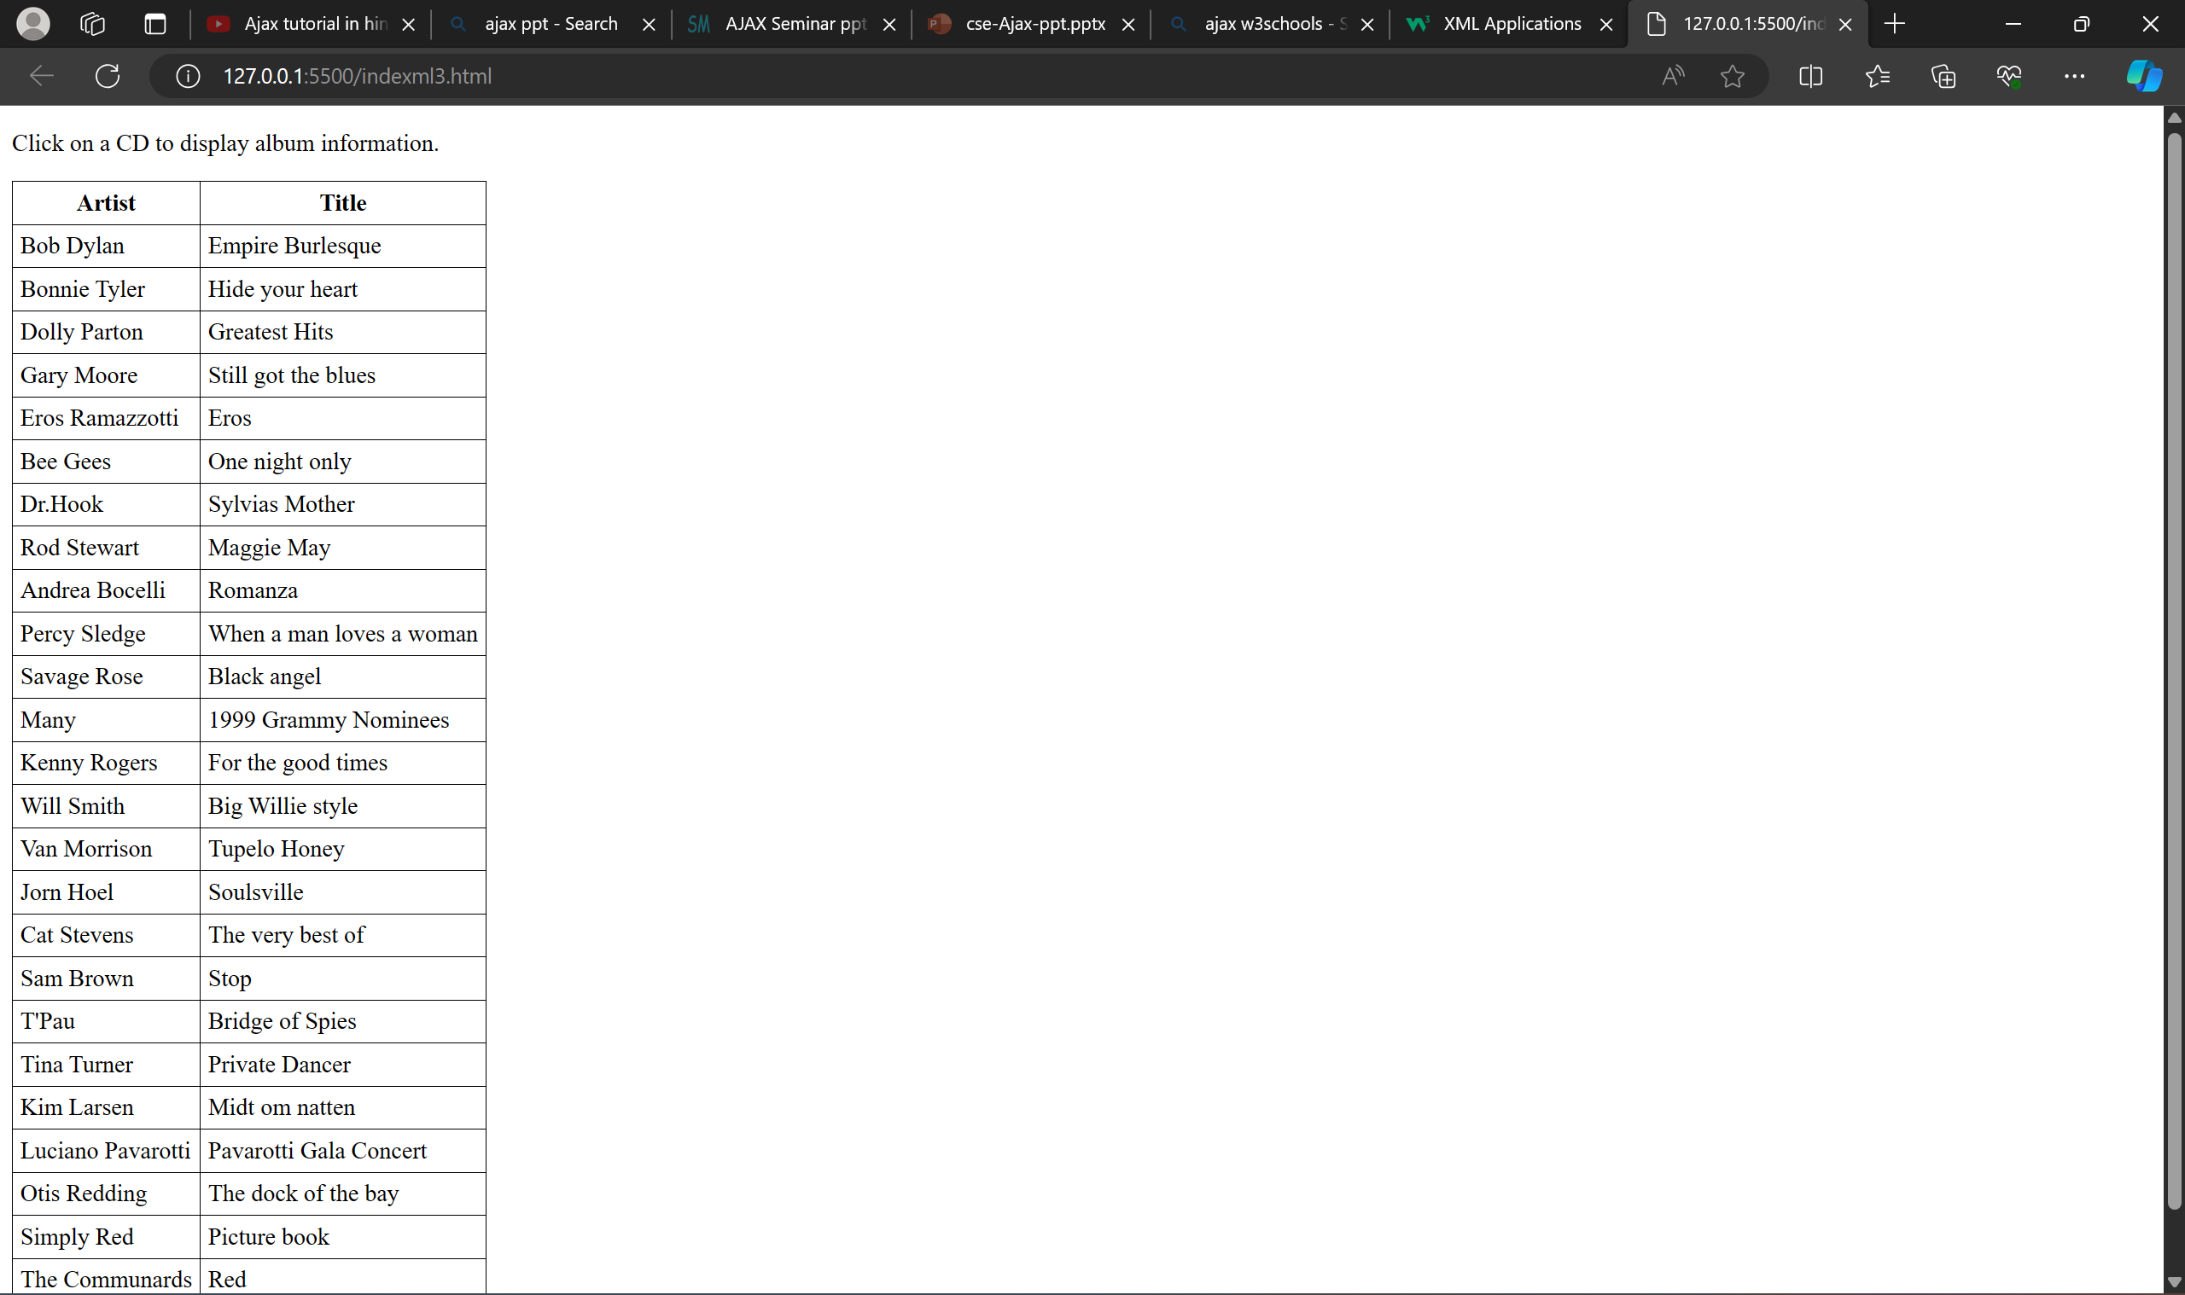

Slide 39
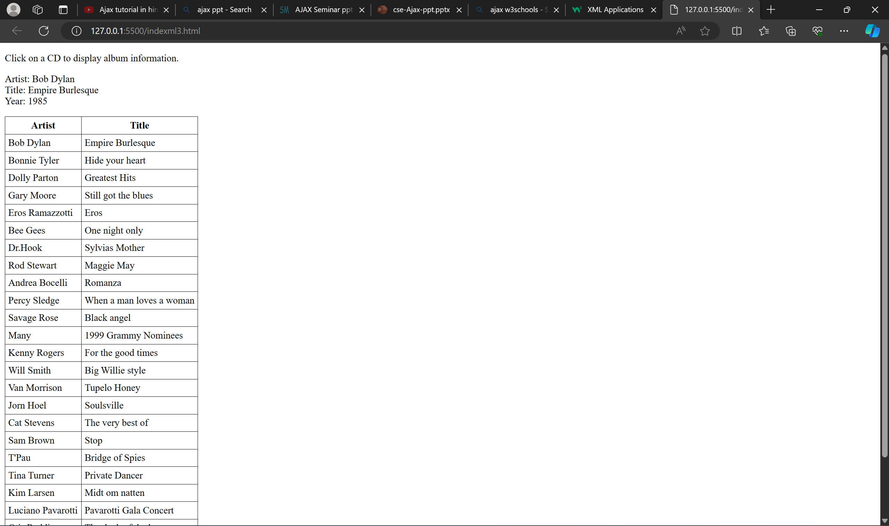

Slide 40
Advantages
page can be refreshed dynamically
response of the interface to user is faster
load much faster because the payload is much smaller
reduces the demand for bandwidth
allows the web applications to be much more efficient
operate more like an application rather than a standalone program

Slide 41
Disadvantages
integration of browsers
hard for the user to bookmark the state of the web page
Conclusions
Ajax provides functionality to create a robust web application.
If an Ajax web application is coded properly it will run faster than and as secure as a non-Ajax program.
Ajax also allows websites to reduce their overall bandwidth usage and server load by reducing the amount of full page loads.

Slide 42
References
AJAX Introduction (w3schools.com)
Learn AJAX Tutorial – javatpoint
AJAX Tutorial | Learn Ajax (tutorialspoint.com)

Slide 43

Thank You

